Slide 1

Spring Fundamentals
MWD

Slide 2
Agenda
Why Spring
Some design concepts
Basic core concepts
Some spring core annotation
Spring unit test
Exercise

Slide 3
Problem
Testability
Maintainability
Scalability
Complexity
Business Focus

Slide 4
Why Spring?
Spring makes programming Java quicker, easier, and safer for everybody. Spring’s focus on speed, simplicity, and productivity has made it the world's most popular Java framework (https://spring.io/why-spring)
From configuration to security, web apps to big data—whatever the infrastructure needs of your application may be, there is a Spring Project to help you build it. Start small and use just what you need—Spring is modular by design (https://spring.io/projects )

Slide 5
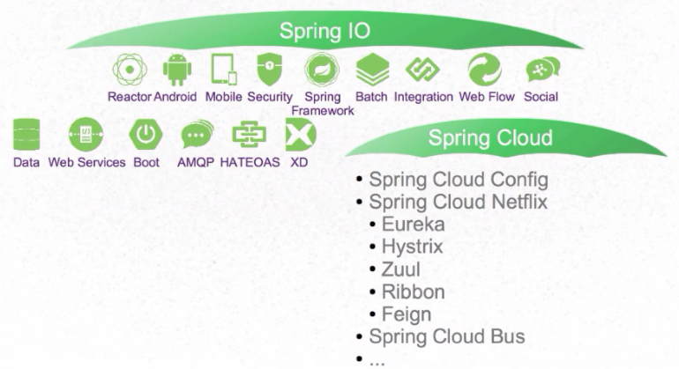
Spring Projects

Slide 6
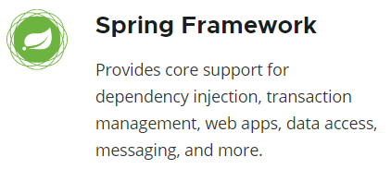
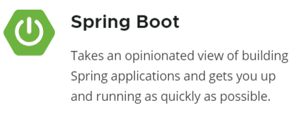
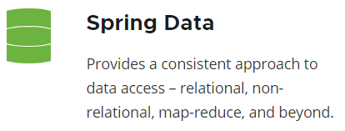
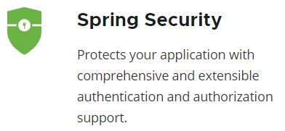
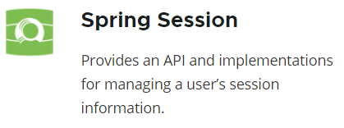
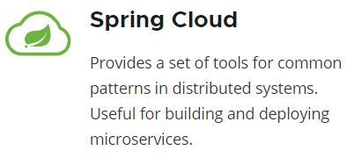
Spring Projects

Slide 7
Principle of Spring
Inversion of Control (IoC)
Dependency Injection
Aspect Oriented Programming
Modular Design

Slide 8

Inversion of Control (IoC)
IoC inverts the flow of control as compared to traditional control flow. In IoC, custom-written portions of a computer program receive the flow of control from a generic framework. A software architecture with this design inverts control as compared to traditional procedural programming: in traditional programming, the custom code that expresses the purpose of the program calls into reusable libraries to take care of generic tasks, but with inversion of control, it is the framework that calls into the custom, or task-specific, code. (wiki)
Example
print “enter your name”
read name
…
store in DB
No IoC IoC
MS-DOS: your code control the
flow of user interaction
GUI Application: window control the
flow of user interaction using events
Notes:
IoC is a key part of what makes a framework different to a library. A library is essentially a set of functions that you can call, these days usually organized into classes. Each call does some work and returns control to the client.
A framework embodies some abstract design, with more behavior built in. In order to use it you need to insert your behavior into various places in the framework either by subclassing or by plugging in your own classes. The framework's code then calls your code at these points. (martin fowler)

Slide 9
Inversion of Control (IoC)
Pros
Loose coupling, easier to test, maintain and extend.
Greater modularity of a program
Centralized configuration
Take care of long nested dependency chains and lifetime of dependencies
Cons
Need framework
Hard to figure out the flow of the application
No build errors
Require dependency management

Slide 10
IoC - DI
IoC
principal
pattern
Service Locator
Events
Delegates
Dependency Injection (DI)
Constructor Injection
Dependency Injection (DI) is a design pattern used to implement IoC. It allows the creation of dependent objects outside of a class and provides those objects to a class through different ways. Using DI, we move the creation and binding of the dependent objects outside of the class that depends on them.
Setter Injection
Interface Injection

Slide 11
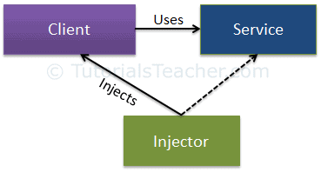
DI
Client class: The client class (dependent class) is a class which depends on the service class.
Service Class: The service class (dependency) is a class that provides service to the client class.
Injector Class: The injector class injects the service class object into the client class.
➔ The injector class creates an object of the service class, and injects that object to a client object.

Slide 12
Modular Design
Modular design is a design principle that subdivides a system into smaller parts called modules, which can be independently created, modified, replaced, or exchanged with other modules or between different systems.
Easy to customize products
Faster to market
Cost efficiency
Sustainability
Allows incremental upgrades

Slide 13
Aspect-Oriented Programming
Aspect-Oriented Programming (AOP) is a programming paradigm which complements Object-Oriented Programming (OOP) by separating concerns of a software application to improve modularization (Spring doc).
OOP: key modularity is the class
AOP: key modularity is the aspect
Before AOP
After AOP
User Service
Admin Service
User Service
Admin Service
Security
Transactions
Logging
Security
Transactions
Logging
Security
Transactions
Logging
Cross-cutting concerns (Aspects)

Slide 14
AOP Concepts
Aspect: a modularization of a concern that cuts across multiple classes.
Joint point: a point during the execution of a program, such as the execution of a method (Spring) or the handling of an exception.
Advice: action taken by an aspect at a particular join point: before, after returning, after throwing, after finally, around
Pointcut: a predicate that matches join points.
Target object (advised object): object being advised by one or more aspects.
AOP proxy: an object created by the AOP framework in order to implement the aspect contracts.
Weaving: linking aspects with other application types or objects to create an advised object. This can be done at compile time, load time, or at runtime (Spring).

Slide 15
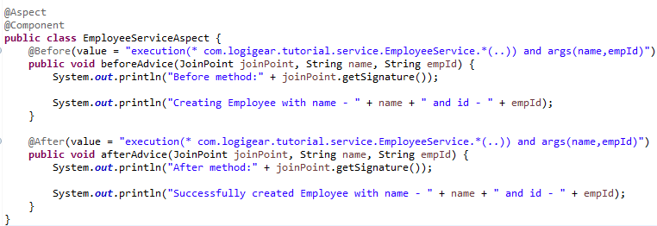
AOP in Spring Sample
Source: \doc\material\demo\Chapter 1\AOPSample

Slide 16
Basic concepts
Annotation
POJO & POJI
Spring Bean
Spring Container

Slide 17
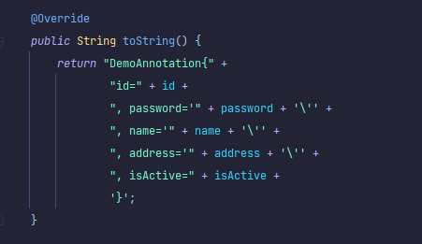
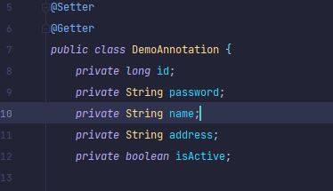
Annotation
1.1 Annotation in Java
Spring Boot Annotations is a form of metadata that provides data about a program. In other words, annotations are used to provide supplemental information about a program. It is not a part of the application that we develop. It does not have a direct effect on the operation of the code they annotate. It does not change the action of the compiled program.

Slide 18
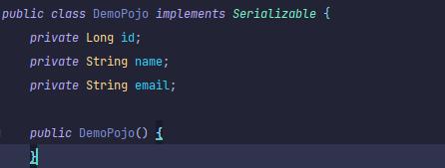
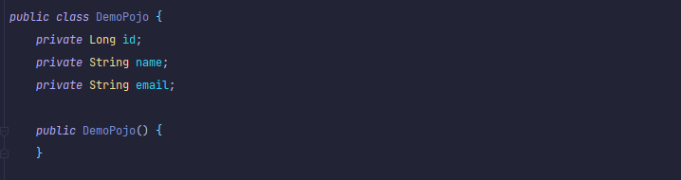
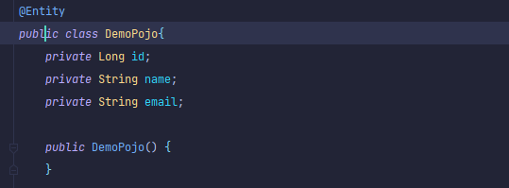
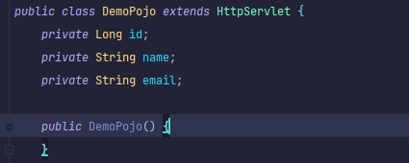
POJO & POJI
2.1 POJO Overview
2.1.2 Not POJO (Implement prespecified interfaces)
This is NOT
a POJO
2.1.1 This is a POJO
POJO stands for Plain Old Java Object.
It is an ordinary Java object, not bound by any special restriction other
than those forced by the Java Language Specification and not requiring any class-path.
2.1.3 Not POJO (Contain prespecified annotations)
2.1.4 Not POJO (Extend prespecified classes)

Slide 19
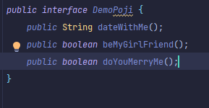
2. POJO & POJI
2.2 POJI Overview
2.2.1 This is a POJI
If a java interface is not coupled with any technology (or) any frame work then such java interface is called “POJI” (plain old java interface)

Slide 20
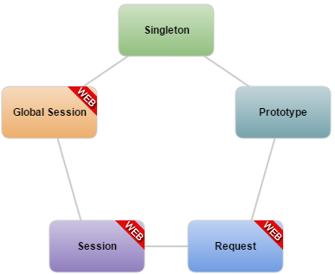
3. Spring Bean
3.2 Bean Scopes
Singleton Scope: This scopes the bean definition to a single instance per Spring IoC container (default).
Prototype Scope: This scopes a single bean definition to have any number of object instances.
Request Scope: This scopes a bean definition to an HTTP request. Only valid in the context of a web-aware Spring ApplicationContext.
Session Scope: This scopes a bean definition to an HTTP session. Only valid in the context of a web-aware Spring ApplicationContext.
Global Session Scope: This scopes a bean definition to a global HTTP session. Only valid in the context of a web-aware Spring ApplicationContext.
3.2.1 Bean Scope

Slide 21
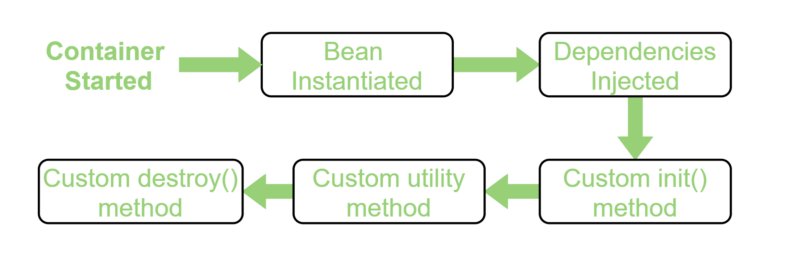
4. Spring Bean
3.3 Spring Bean life cycle
3.3.2 Spring Bean Life-Cycle
Bean life cycle is managed by the spring container.
When we run the program then, first of all, the spring container gets started. After that, the container creates the instance of a bean as per the request and then dependencies are injected.
And finally, the bean is destroyed when the spring container is closed.

Slide 22
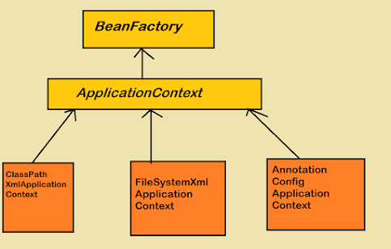
4. Spring Container
4.1 BeanFactory Overview
BeanFactory is the actual container which instantiates, configures, and manages a number of bean's. These beans are typically collaborate with one another, and thus have dependencies between themselves. These dependencies are reflected in the configuration data used by the BeanFactory.
4.1.1 Spring IOC Container

Slide 23
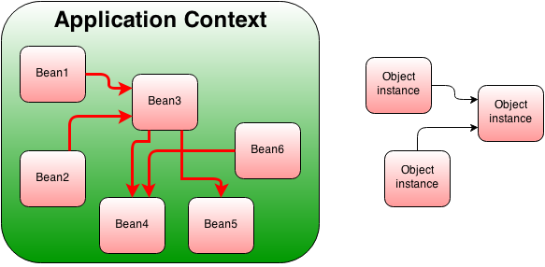
4. Spring Container
4.2 Application Context Overview
BeanFactory and ApplicationContext both are Java interfaces and ApplicationContext extends BeanFactory. Both of them are configuration using XML configuration files. In short BeanFactory provides basic Inversion of control(IoC) and Dependency Injection (DI) features while ApplicationContext provides advanced features.
4.2.1 Application Context

Slide 24
4. Spring Container
3.2 Compare BeanFactory and ApplicationContext
BeanFactory
ApplicationContext
BeanFactory instantiate bean when you call getBean() method.
ApplicationContext instantiate Singleton bean when container is started, It doesn't wait for getBean() to be called.
BeanFactory doesn't provide support for internationalization.
ApplicationContext provides support for it.
BeanFactory ability to publish event to beans that are registered as listener.
One of the popular implementation of BeanFactory interface is XMLBeanFactory.
One of the popular implementation of ApplicationContext interface is ClassPathXmlApplicationContext.
BeanFactory by default its support Lazy loading.
ApplicationContext by default support Aggresive loading.

Slide 25
Tools
Frontend
VSCode
Angular CLI
NPM
Backend
Eclipse/SpringToolSuite
MVN
OpenJDK 16

Slide 26
Lombok
A library that generates Java code based on annotations. It keeps the code samples concise, reducing the boilerplate so the reader can focus on what it matters.
Homepage: https://projectlombok.org/

Slide 27
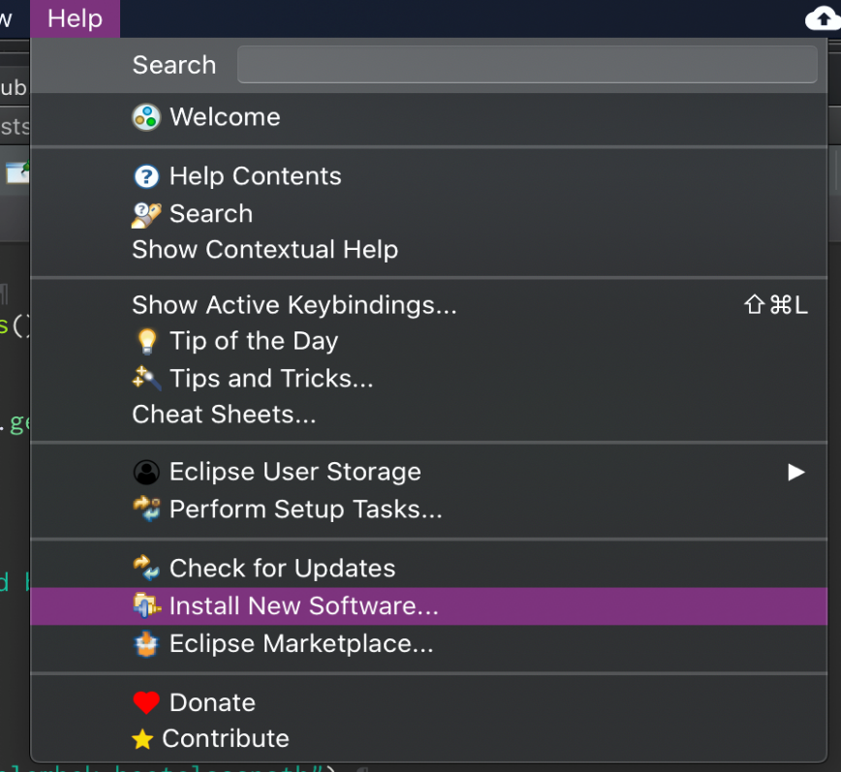
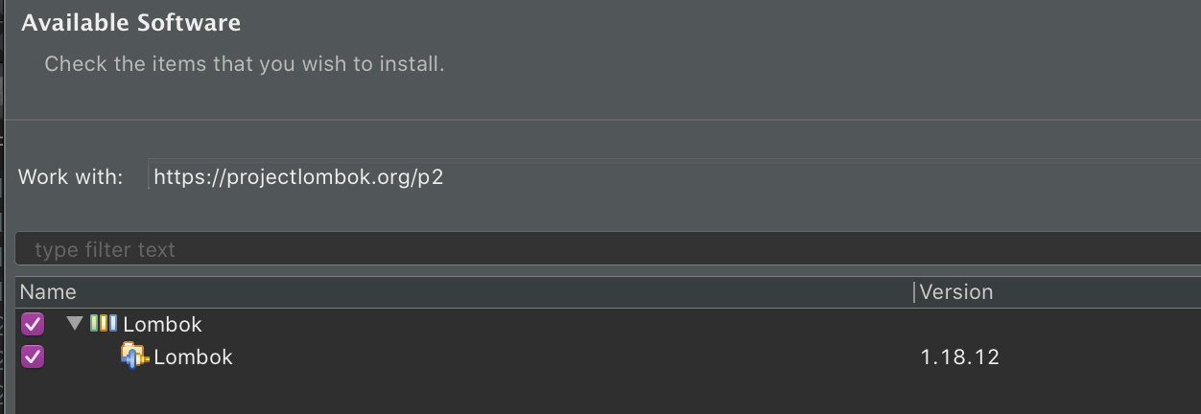
Install Lombok
1. Install via eclipse plugin installer: Help/Install New Software…
2. Use update site https://projectlombok.org/p2

Slide 28
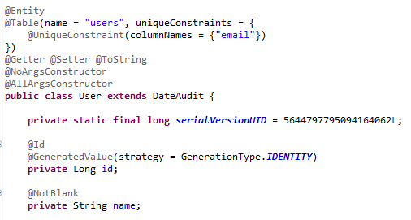
Use Lombok
By adding the @Getter, @Setter, @ToString annotations we told Lombok to, well, generate these for all the fields of the class.
@NoArgsConstructor will generate a constructor with no parameters.
@AllArgsConstructor generates a constructor with 1 parameter for each field in your class.

Slide 29
Important Spring Annotations
@Configuration
@ComponentScan
@Component
@Service
@Autowired
@Bean

Slide 30
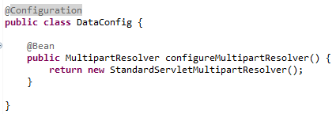
@Configuration
Mark a class as a source of the bean definition.
Is a component of the system that you want to wire together.
Methods must have the @Bean annotation to mark it as a bean producer.
@Bean - indicates that a method produces a bean to be managed by the Spring container.

Slide 31
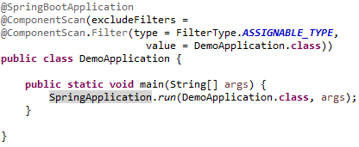
@ComponentScan
Leverage a normal Java class to a Spring bean.
Can be auto-scanned by the Spring Boot Application during the start-up time.
Can be used to inject wherever Spring framework need.

Slide 32

@Component
Leverage a normal Java class to a Spring bean.
Can be auto-scanned by the Spring Boot Application during the start-up time.
Can be used to inject wherever Spring framework need.

Slide 33
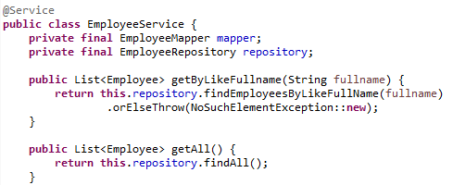
@Service
Act as a normal @Component annotation and has the same functions.
It tells Spring that it's safe to manage them with more freedom than regular components
Holding business logic, no encapsulated state

Slide 34



@Autowired
Can be used to inject appropriate Spring bean into the application parts.
Three ways to use the annotation: Field-level, Method-level, Setter-level.

Slide 35
Summary
Overview of Spring ecosystem
Basic concepts of spring
Basic Spring annotations
Tools and IDE
Sample
Exercise

Slide 36

Thank You!

